Slide 1


PREDICTING COLLISION SEVERITY

Slide 2


Why is it important to know collision severity?
Help emergency services plan ahead on way to the collision.
Better direct emergency vehicles to the most serious accidents.
Better outcomes from the accident for all involved.

Slide 3

Our data set
From the Traffic Records for the city of Seattle
Over 194,000 records for accidents from 2004 to present
37 different attributes covering time/date, road type, weather, road conditions and numbers involved

Slide 4
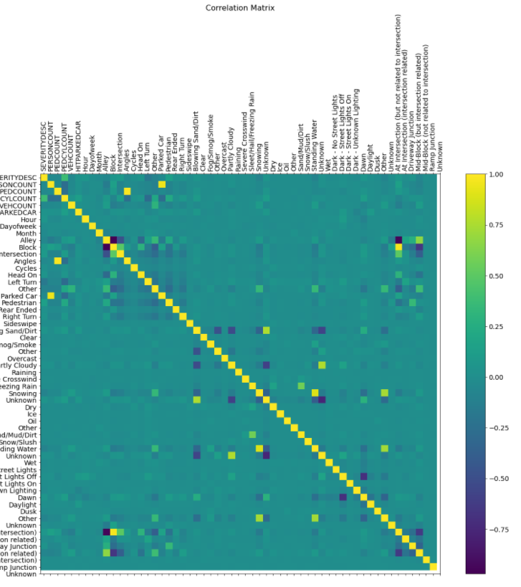
What we did
Cleansed the data, including removing several attributes, based on the correlation matrix, resulting 47 different features.
Build machine learning models using decision trees and logistic regression.
Measured accuracy using F1 score and used confusion matrices.

Slide 5
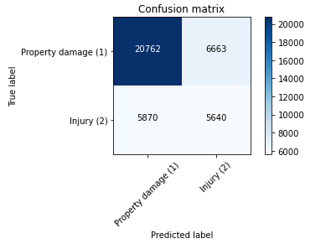
The decision tree model
Most accurate when depth is 37
Accuracy: 0.6781045331963529
F1 score: 0.6811032208372303
Predict 'property damage' correctly: 75.7%
Predict 'property damage' when it's an 'injury collision': 51.0%
Predict 'injury' correctly: 49.0%
Predict 'injury' when it's 'property damage': 24.3 %

Slide 6
The logistic regression model
F1-score (lr): 0.7003
Log loss: 0.805498175639136
Predict 'property damage' correctly: 96.5%
Predict 'property damage' when it's an 'injury collision': 76.5 %
Predict 'injury' correctly: 23.5 %
Predict 'injury' when it's 'property damage': 3.5 %

Slide 7
Main Outcomes
the logistic regression model was more accurate overall than the decision tree model, based on the F1 scores
logistic regression model better at predicting a collision involving only property damage
correct 96.5% of the time
logistic regression model better at predicting a collision involving injury
correct 49% of the time
Both models significantly mis-categorise the majority of the more serious collisions involving injury as ‘property damage’ collisions

Slide 8
Conclusions
our aim was to build a model for predicting the severity of a collision to prepare the emergency services
we were successfully able to build two machine learning models that could be used to predict the severity, one with 96.5% accuracy in predicting the lower severity ‘property damage’ collisions
both models had lower accuracy when predicting ‘injury’ collisions.
our models would therefore not be suitable for use at the moment.
but they do show promise and refinement, using under-sampling of the training data set, is likely to produce better results in future.

